Slide 1
ABC Call Volume Trend Analysis
Presented by: Mannat Sandhu
https://docs.google.com/spreadsheets/d/1QctJbi6R8Rm6MvfX1Izohzs1J-XivC7y/edit?usp=drive_link&ouid=101663467761144856859&rtpof=true&sd=true

Slide 2
Introduction
A Customer Experience (CX) team plays a crucial role in a company.
They analyze customer feedback and data, derive insights from it, and share these insights with the rest of the organization.
The goal is to attract, engage, and delight customers, turning them into loyal advocates for the business.

Slide 3
Project Description
This project is about the Customer Experience (CX) analytics, specifically focusing on the inbound calling team of a company.
The dataset includes various details such as the agent's name and ID, the queue time, the time of the call, the duration of the call, and the call status for span of 23 days.

Slide 4

Tech stack used
In this project I have used Microsoft excel 2010.

Slide 5
Approach
Download Data sets
Import data sets into MS Excel
Understanding the Datasets
Cleaning and preparing data for analysis.

Slide 6
Data cleaning
The data set included by 13 columns and 117988 rows.
First, we’ll calculate the number of blanks in each column using COUNTA and COUNTBLANK().
There are 47877 blanks cells present in Wrapped_by column.

Slide 7
Data imputation:
‘Agent’ is imputed for answered and transferred calls.
‘Abandoned’ is imputed for abandon calls.
Create a new column date by extracting date from date and time column using int function.
Delete Unwanted column: Agent_ID, Queue_time, Duration, Ringing, IVR duration.

Slide 8
Data Analytics Tasks
Average Call Duration
Call Volume Analysis
Manpower Planning
Night Shift Manpower Planning

Slide 9
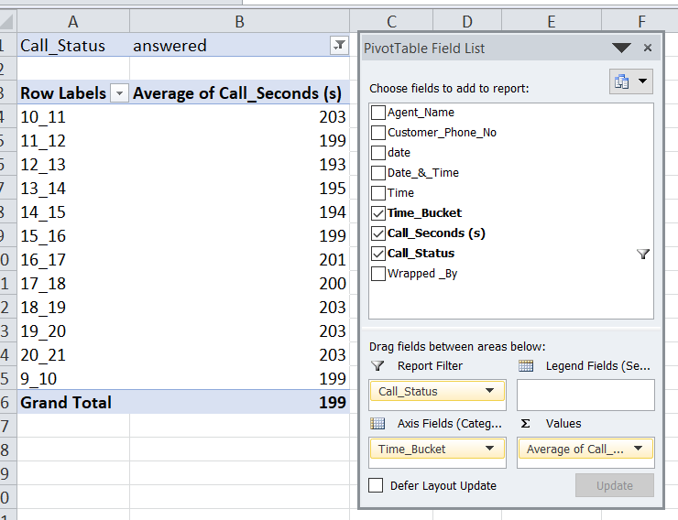
Average Call Duration
Create a pivot using columns: time_bucket, call_seconds and call_status.

Slide 10
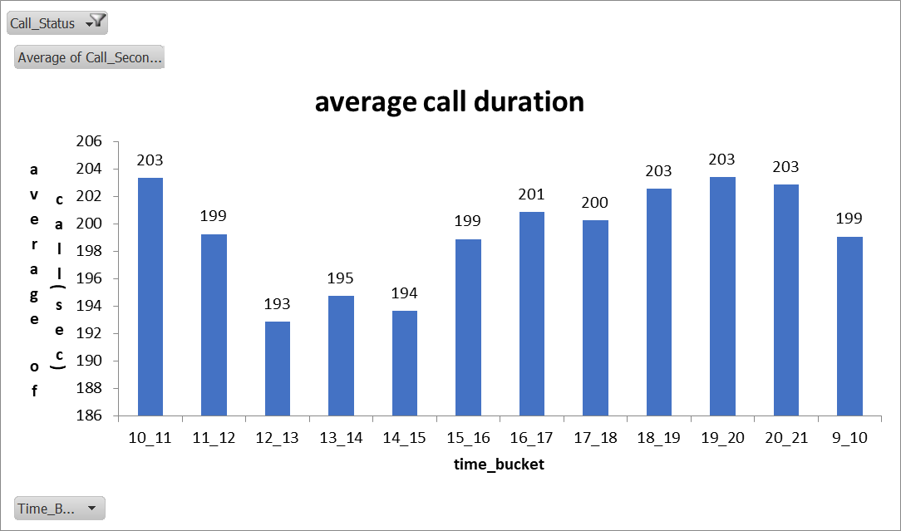

Slide 11
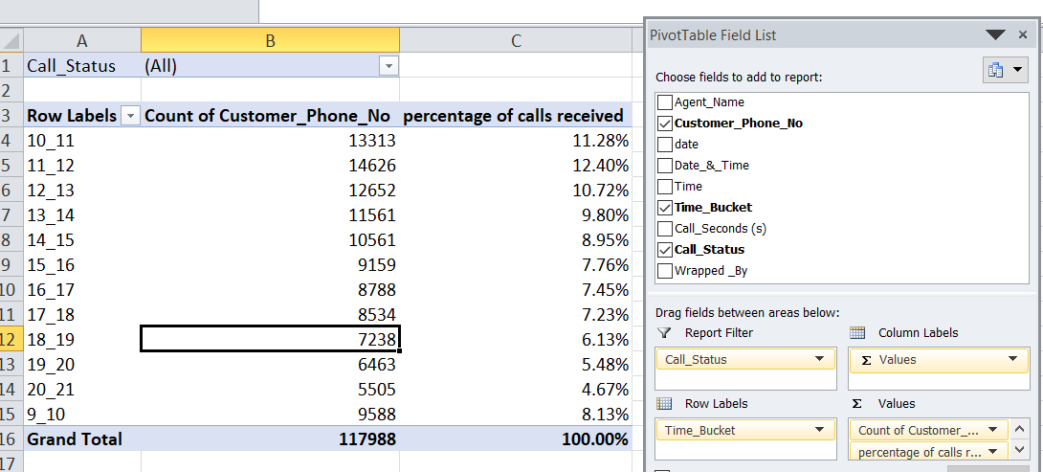
Call Volume Analysis
Create a pivot using columns: customer_phone_no, time_bucket and call_status.

Slide 12
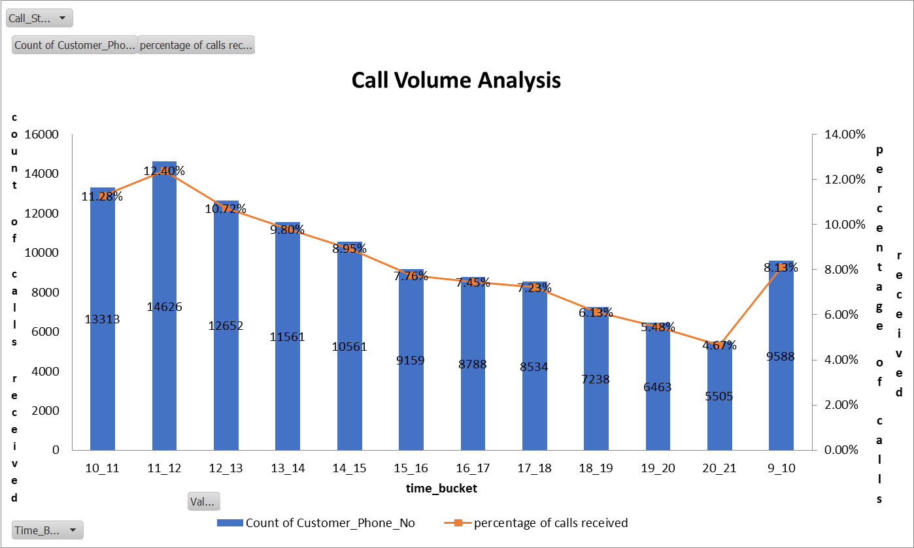
And then created a combo chart.

Slide 13
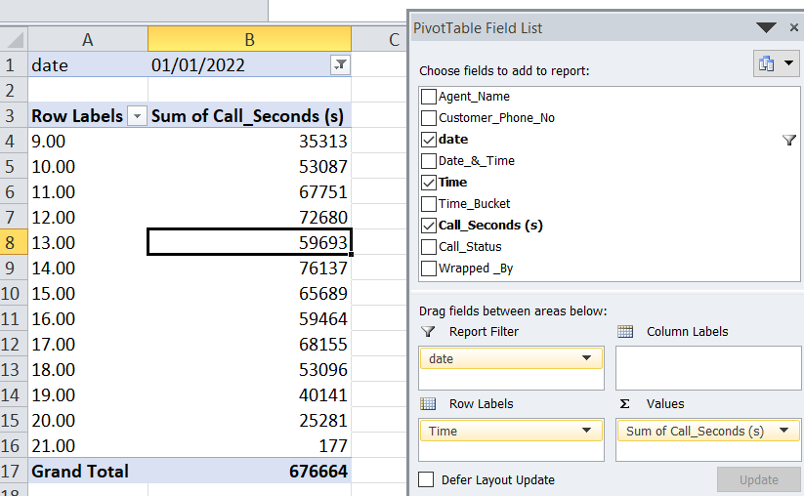
Manpower Planning
We’ll create a pivot table using following columns:

Slide 14
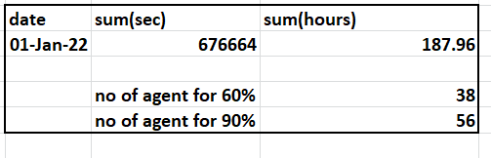
From pivot we get sum of call seconds for 1 jan 2022.
Now we’ll convert seconds into hours by dividing it with 3600.
Then we’ll count no of agents required for 60% by dividing the sum of call seconds in hours with 5.
Finally obtain no of agents required using formula =38/60*90

Slide 15
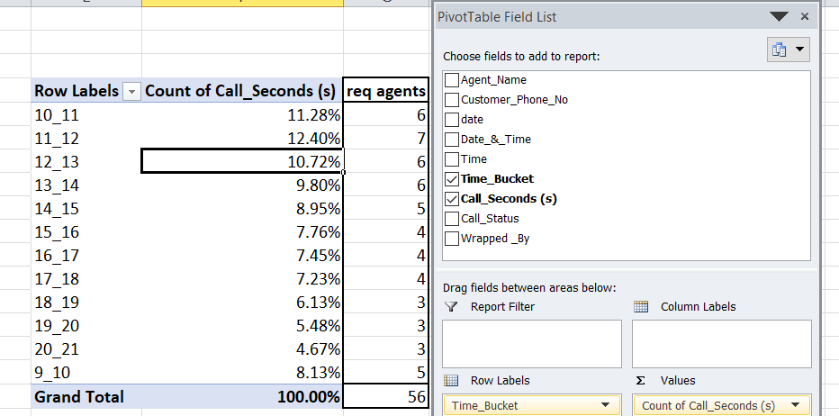
Now create another pivot using following:
And allocate the no of required agents for each time bucket by multiplying 56 with percentage of count of call seconds.

Slide 16
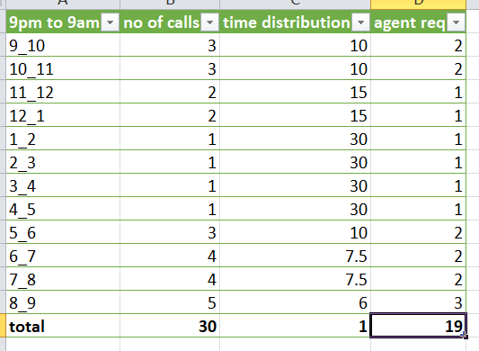
Night Shift Manpower Planning
We’ll first create a table from given data.
Then we’ll calculate the time distribution by dividing total calls with no of calls in each time bucket.

Slide 17
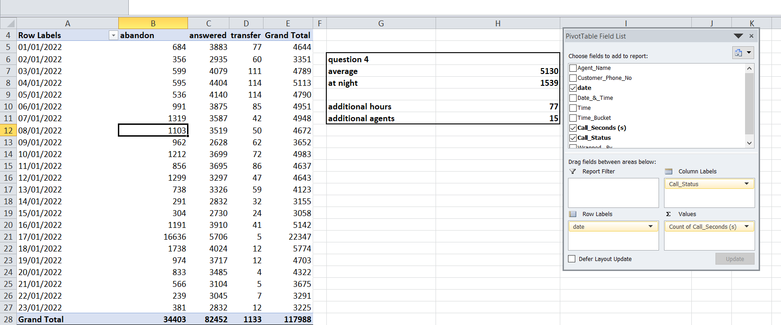
To obtain the required agents we’ll create a pivot table from assumption using following columns:
We’ll obtain the average using average for grand total.
Then we’ll calculate abandoned 30% from average to get call rate at night.

Slide 18
Now we’ll calculate the additional hours by multiplying average at night with average call duration and 0.9, then divide with 3600.
Obtain the additional agents by dividing additional hours with 5.
Now obtain no of additional agents in each time bucket by dividing additional agents with time distribution.

Slide 19
Results
Average call duration is 199 sec for answered calls.
Highest no of calls are in time bucket of 11_12 followed by 10_11.
No of agents required to reduce abandon rate to 10% is 56.
Manpower required at night is for 15 to 19 agents.

